Slide 1
QTL MAPPING & Analysis
Sujan Mamidi &
Divyashree Nageswaran

Slide 2
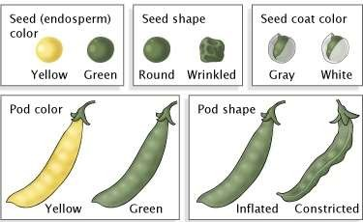
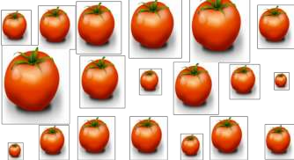
Quantitative traits
Qualitative traits
Polygenic (quantitative trait loci)
Continuum of measures (interval
scale).
Trait expression may show profound environmental effect
Continuous variation
Genes have smaller effects
Mapping requires QTL analysis
ExFruit shape: a quantitative trait
cubocube.com
Monogenic or oligogenic
Discreet phenotypic classes
(nominal scale).
Typically, environmental effect on trait expression is absent or low
Discontinuous variation
Genes have large effect
Mapped as visible marker
www.nature.com

Slide 3
QTL MAPPING
Many agriculturally important traits such as yield, quality and some forms of disease resistance are controlled by many genes and are known as “quantitative traits or polygenic or multifactorial or complex traits”.
These traits show continuous variation in a population.
These traits do not fall into discrete classes.

Slide 4
Ex: Continuous distribution

Slide 5
Quantitative Trait Loci (QTL)
Region of the genome that is associated with a quantitative trait.
It can be a single gene or cluster of linked genes.
QTL characteristics
These traits are controlled by multiple genes, each segregating according to
Mendel's laws.
These traits can be affected by environment to varying degrees.
Individual gene effects is small
The genes involved can be dominant, or co- dominant.
The genes involved can be subject to epistasis or pleiotrophic effect.

Slide 6
QTL Mapping
Identifying genomic regions associated with trait variation is known as QTL mapping. It involves testing DNA markers throughout the genome for the likelihood that they are associated with a QTL.
QTL analysis is usually undertaken in segregating mapping populations.
Genes and markers segregate via chromosome recombination during meiosis,

Slide 7
Objectives in QTL Mapping
The basic objective is to detect QTL, while minimizing the occurrence of false positives (Type I errors, that is declaring an association between a marker and QTL when in fact one does not exist).
To identify the regions of the genome that affects the trait of interest.
To analyze the effect of the QTL on the trait.
How much of the variation for the trait is caused by a specific region?
What is the gene action associated with the QTL – additive effect? Dominant effect?
Which allele is associated with the favorable effect?

Slide 8
Prerequisites for QTL mapping
Availability of a good linkage map
A segregating population derived from parents that differ for the trait(s) of interest
Trait/Traits – Phenotypic values

Slide 9
Methods to detect QTLs
Single-marker analysis (SMA)
Simple interval mapping (SIM)
Composite interval mapping (CIM)
Multiple Interval Mapping (MIM)
Bayesian Interval Mapping (BIM)
And many more

Slide 10
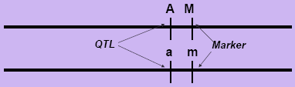
Single-Marker Analysis (SMA)
Also known as single-point analysis. It is the simplest method for detecting QTLs associated with single markers.
This method does not require a complete linkage map and can be performed with basic statistical software programs.
The statistical methods used for single-marker analysis include
t-tests, analysis of variance (ANOVA) and linear regression.
Linear regression is most commonly used because the coefficient of determination ( R²) from the marker explains the phenotypic variation arising from the QTL linked to the marker.

Slide 11

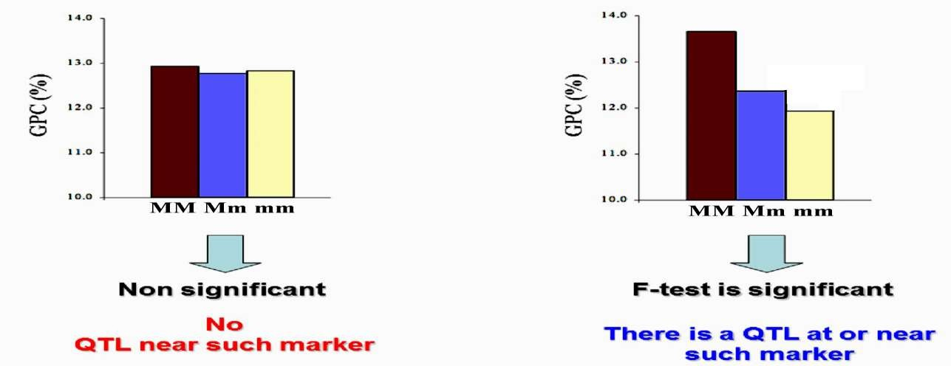


Slide 12
Limitations
Likelihood of QTL detection significantly decreases as the distance between the marker and QTL increases
It cannot determine whether the markers are associated with one or more markers QTLs
Only good with a high dense map
m1
m2
QTL

Slide 13
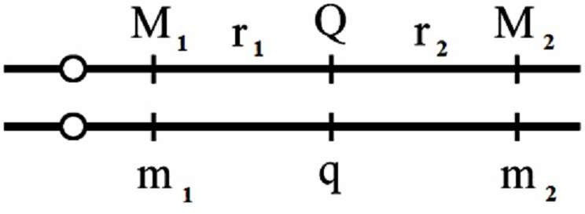
Simple Interval Mapping (SIM)
It was first proposed by Lander and Bolstein.
It takes full advantages of the linkage map.
This method evaluates the target association between the trait values and the genotype of a hypothetical QTL (target QTL) at multiple analysis points between pair of adjacent marker loci (target interval).

Slide 14
Presence of a putative QTL is estimated if the log of odds ratio exceeds a critical threshold.
The principle behind interval mapping is to test a model for the presence of a QTL at many positions between two mapped loci.
0cM
5cM
10cM
15cM
m1
m2
QTL
0cM
5cM
10cM
15cM
m1
m2

Slide 15
Statistical method used for SIM
Maximum Likelihood Approach
It is assumed that a QTL is located between two markers,
Searches for the best approximation for quantitative trait distribution that are observed for each marker class.
Models are evaluated by comparing the likelihood of the observed distributions with and without finding QTL effect

Slide 16
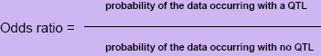
Logarithm of the odds ratio (LOD score):
Linkage between markers is usually calculated using odds ratio.
This ratio is more conveniently expressed as the logarithm of the ratio, and is called a logarithm of odds (LOD) value or LOD score.
LOD values of >3 are typically used to construct linkage maps.
LOD of 2 means that it is 100 times more likely that a QTL exists in the interval than that there is no QTL.

Slide 17
LOD of 3 between two markers indicates that linkage is 1000 times more likely (i.e. 1000:1) than no linkage.
LOD values may be lowered in order to detect a greater level of linkage or to place additional markers within maps constructed at higher LOD values.
The LOD score is a measure of the strength of evidence for the presence of a QTL at a particular location.

Slide 18




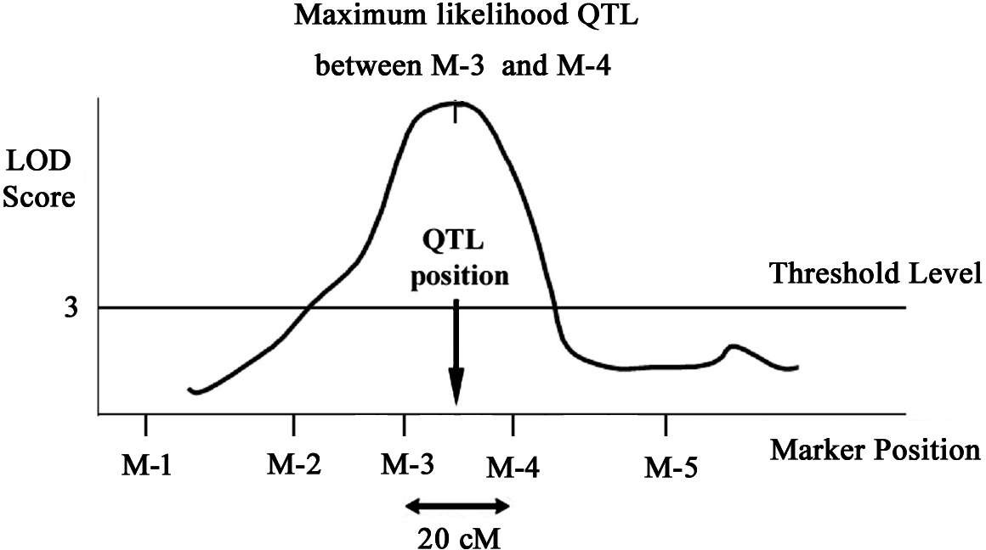
LOD curve

Slide 19
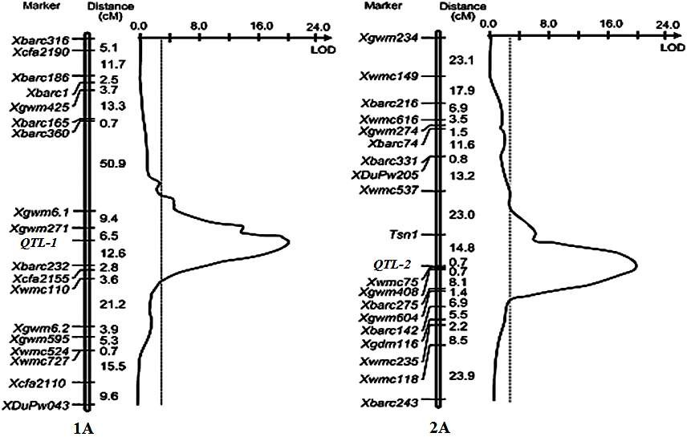



Slide 20
Limitations:
Location and effects of detected QTLs are confounded
QTL positions not precisely detected
Power to detect QTL is low when marker density is low
Multiple comparison increases false positives

Slide 21
Composite Interval Mapping (CIM)
Developed by Jansen and Stam in 1994
It combines interval mapping for a single QTL in a given interval with multiple regression analysis
Fits both the effects of a QTL as well as the effects of covariates (subset of selected genetic markers)
Uses some markers as cofactors
It is more precise and effective when linked QTLs are involved.
It fits parameters for a target QTL in one interval while simultaneously fitting partial regression coefficients for "background markers" to account for variance caused by non-target QTL.

Slide 22
Advantages:
By using linked markers as cofactors, the test is not affected by QTL outside the region, thereby increasing the precision of QTL mapping.
By eliminating much of the genetic variance by other QTL, the residual variance is reduced, thereby increasing the power of detection of QTL.
Problems
The effects of additional QTL will contribute to sampling variation.
If two QTL are linked their combined effects will cause biased estimates.

Slide 23
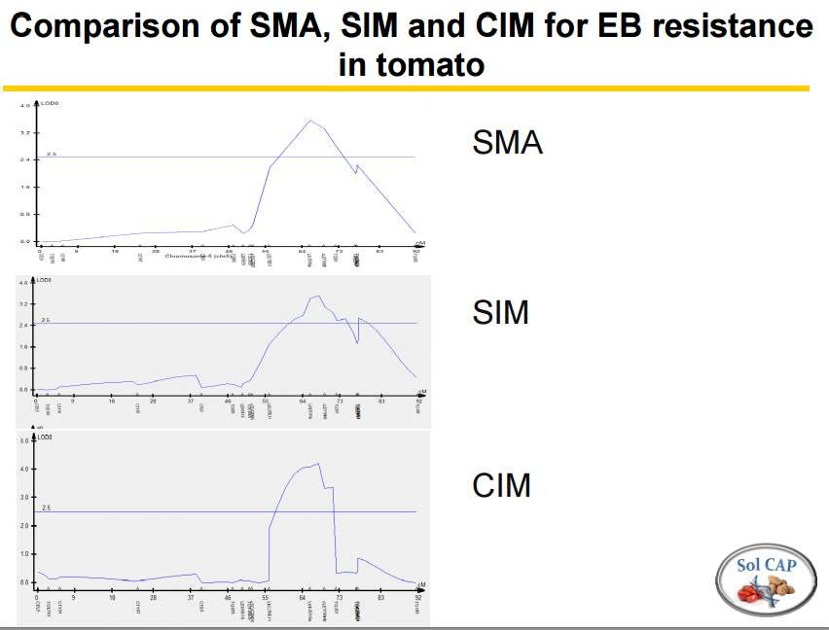
http://solcap.msu.edu/pdf%20files/5PAA_Douches_2_Mapping_Populations.pdf

Slide 24
Multiple Interval Mapping (MIM)
It is a modification of simple interval mapping.
It utilizes multiple marker intervals simultaneously to fit
multiple putative QTL directly in the model for mapping QTL.
It provides information about number and position of QTL in the genome.
It also determines interaction of significant QTLs and their contribution to the genetic variance.
Helps study epistatic interactions

Slide 25
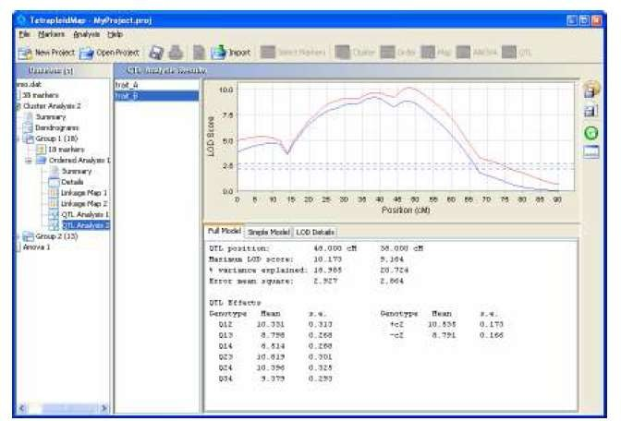
Polyploids
Generally, QTL mapping in allopolyploid genomes is same as diploids
However, QTL mapping in autopolyploid genomes require different strategies
QTL mapping in autopolyploids require different analytical strategies
Tetraploid map

Slide 26
Merits of QTL Mapping
Identification of novel genes
Where mutant approaches fail to detect genes with phenotypic functions , QTL mapping can help
Good alternative when mutant screening is laborious and expensive e.g circadium rhythm screens
Can identify New functional alleles of known function genes
e.g.CRY2 gene

Slide 27
LIMITATIONS
Mainly identifies loci with large effects.
Small additive effects / epistatic loci are not detected and may require further analyses.

Slide 28
Practical considerations
QTL regions different for different populations (for same trait) - Hard to compare unless we have common markers
Presence of Physical map to compare helps identify physical positions and candidate genes

Slide 29
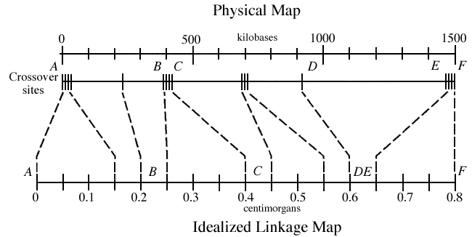
Genetic Map - Physical map
Gene
QTL
http://www.informatics.jax.org/silver/figures/figure7-5.shtml

Slide 30
Q gene input – Has 3 sections
[Header] Study Name Xanthomonas Mating string r Genotype symbols ABHxx- Parent1 RT0034 Parent2 Cypress

Slide 31
Strings
b=backcrossing,
d=doubled-haploid creation,
s=selfing, and
i=random intercrossing
r = ril
BC1F1 - b
F2 - s
F3 -ss
series of three backcrosses followed by a selfing - bbbs.
backcross twice, self once, randomly intercross twice, and backcross again - bbsiib.

Slide 32
Genotype symbols
Symbols used to represent the
parent 1 homozygote AA,
parent 2 homozygote aa,
heterozygote Aa,
the dominant marker phenotypes a_ and A_,
and missing data
Ex: Genotype symbols ABHxx-

Slide 33
2nd Section
[Locus]
Marker Chrom position(cM) Alleles
Ex:
AP2882 1 0 AAAAA-BB-BBBAABAABAAAAAAAAA RM10149 1 14.9 AAAAAAAABBBBABBAB-AAAAAA

Slide 34
[Trait]
Name_of_trait Type Values
AMY_AR M 21.8 21.85 22.7 22.65 22.15 23.3 23.4 23.9 22.95
BLANKS_AR M 0 35 46.65 20 31.7 26.7 21.7 0 31.65 0 38.3
Type:
N - nominal
O - ordinal
M - metric.

Slide 35
Nominal – discrete classes
Ex: color of fruit – Yellow, orange, red, dark red
Ordinal – Classes based on order
Ex: Plant height – low, medium, tall
Disease – HS, S, N, R, HR
Metric – Numeric values
Ex: plant height - 5 5.1 5.4 5.7

Slide 36
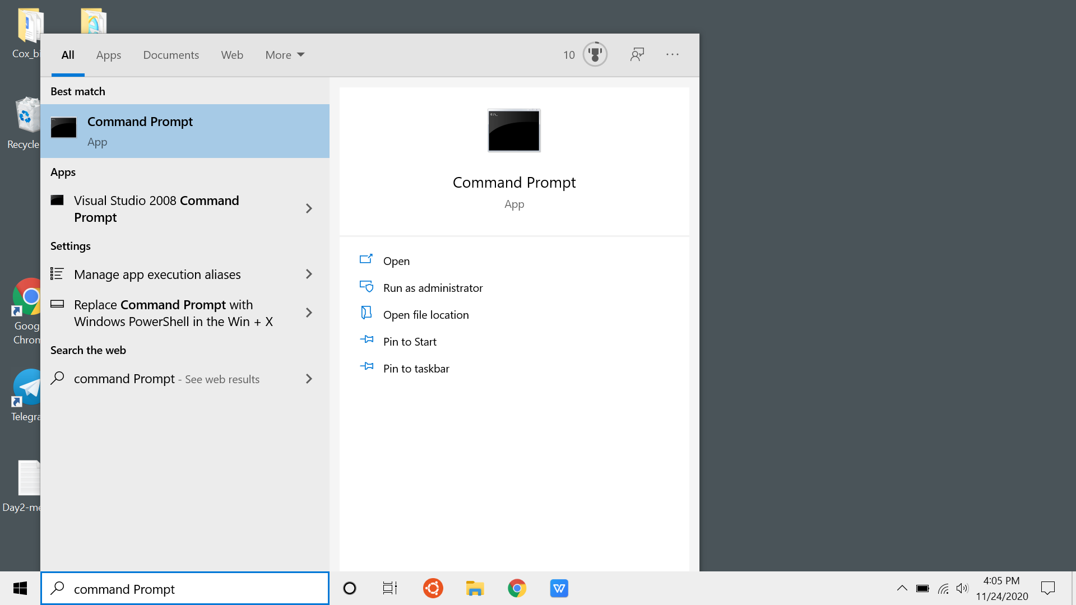
Qgene
Data courtesy - Phillip McClean, NDSU
Open Command Prompt

Slide 37
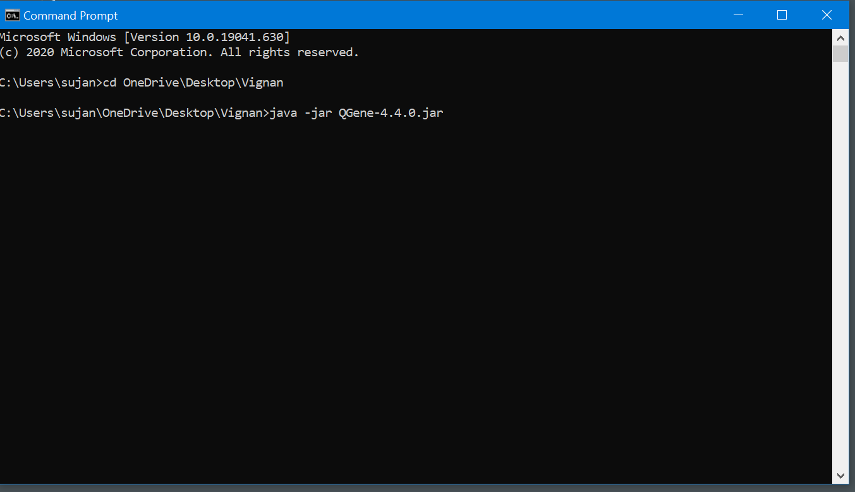
type
cd path-foor-qgene
java -jar Qgene-4.4.0.jar
Open Command Prompt

Slide 38
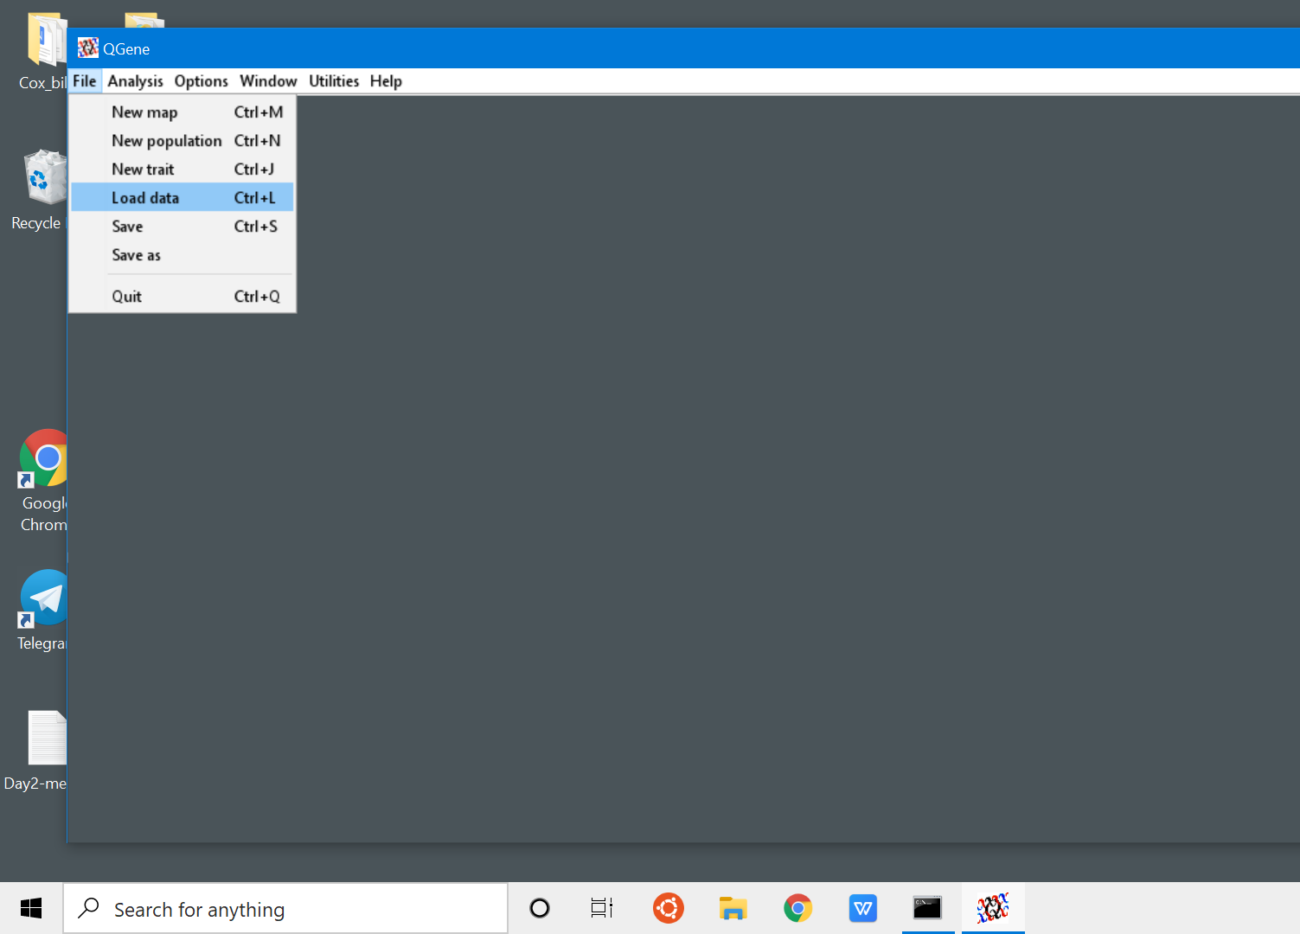
File/Load data

Slide 39
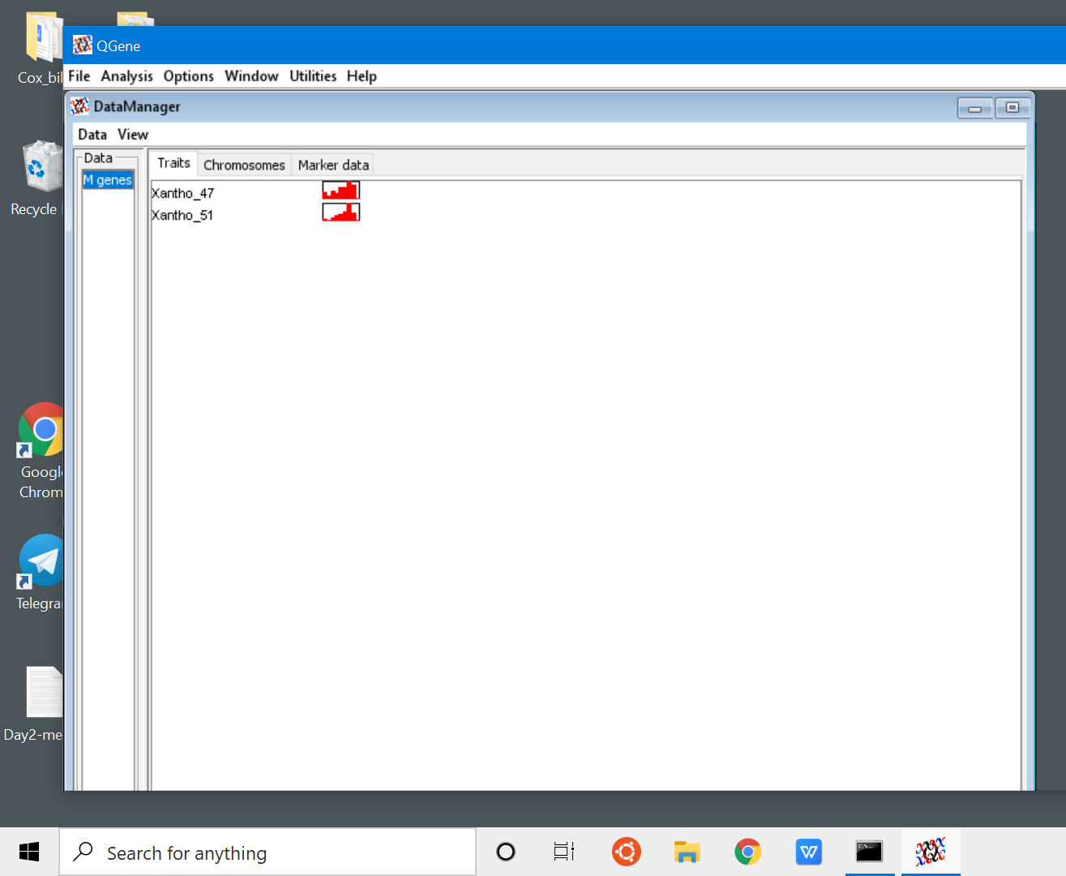
Data loaded - 2traits

Slide 40
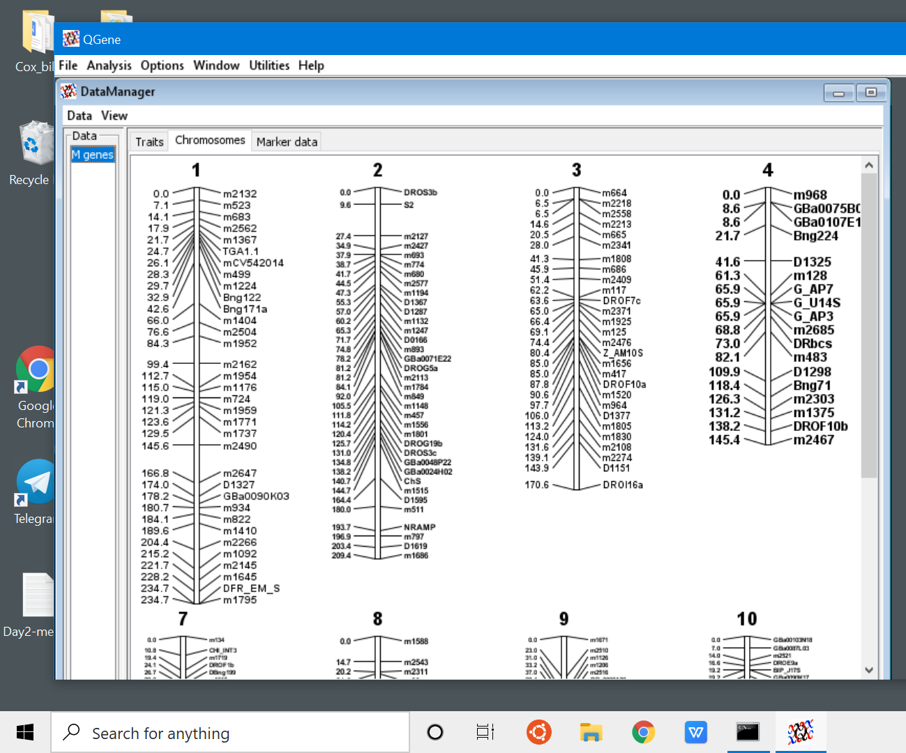
Data loaded - Chromosomes view

Slide 41
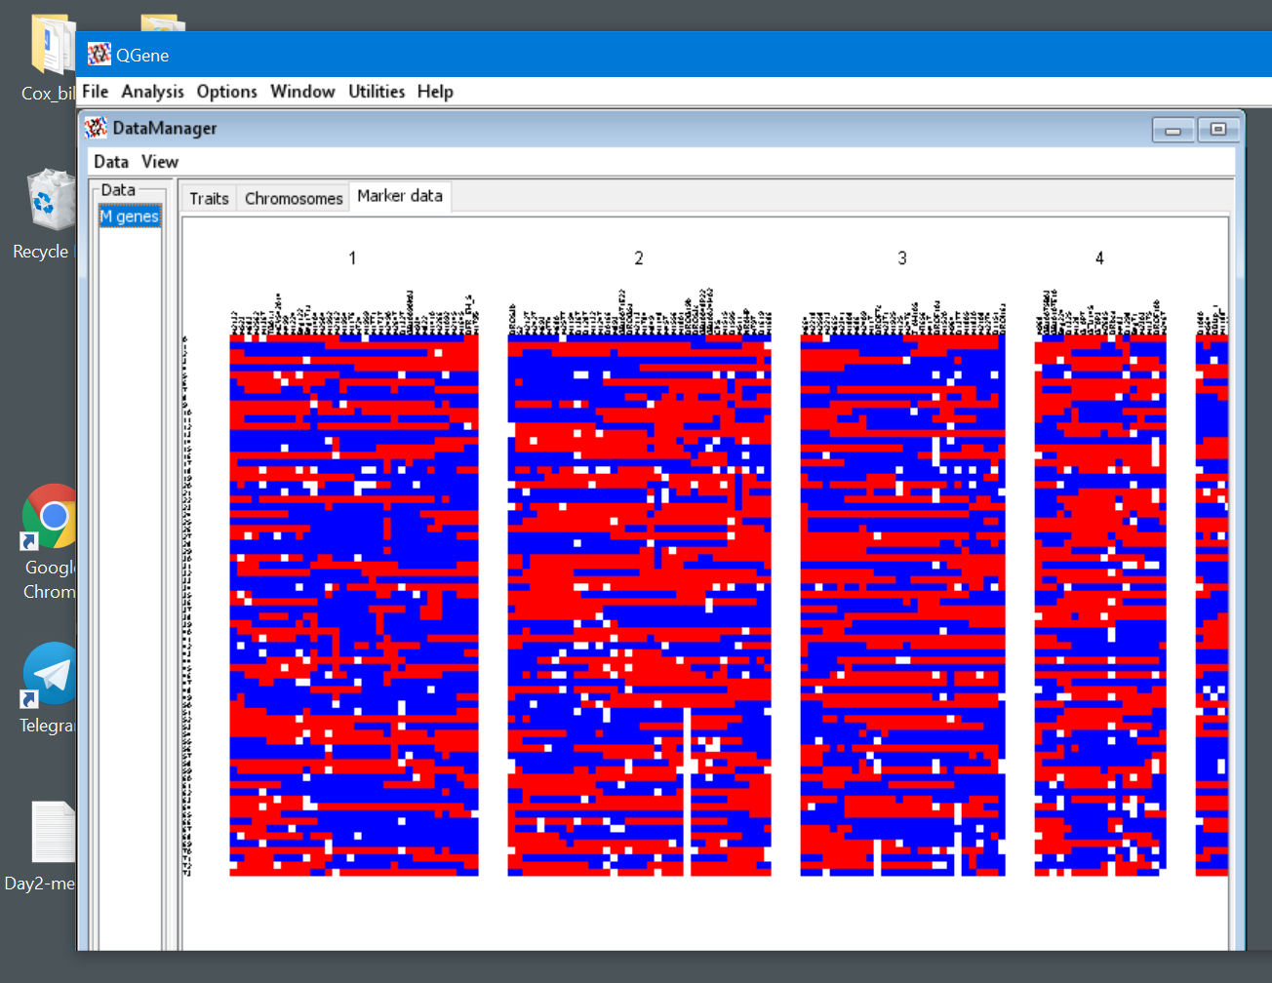
Data Loaded - Marker Data

Slide 42
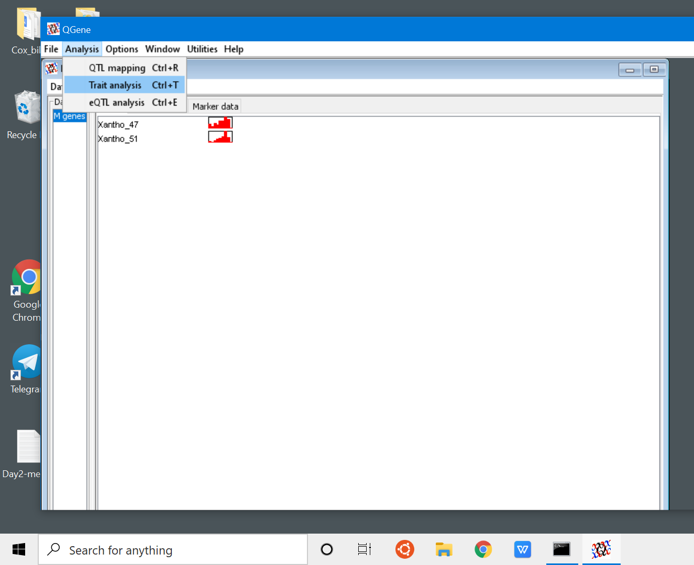
Analysis/Trait analysis

Slide 43
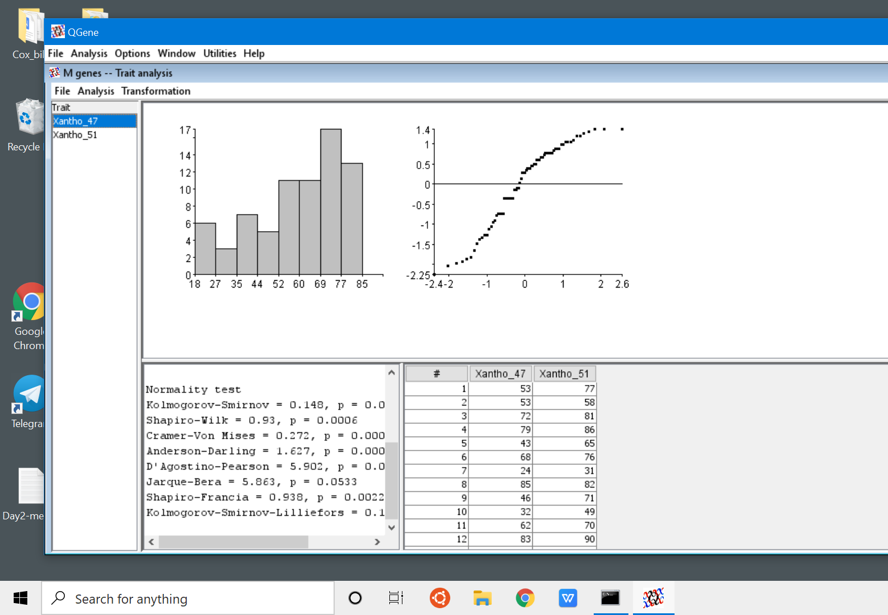
Trait :
histogram
Normality tests

Slide 44
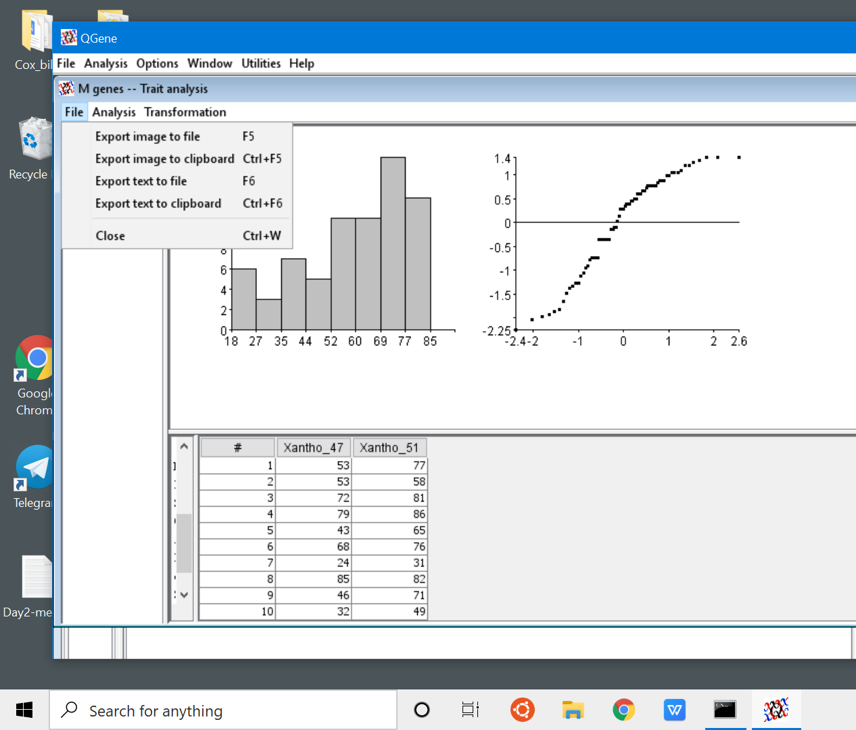
File - options to save data or copy test to clipboad

Slide 45
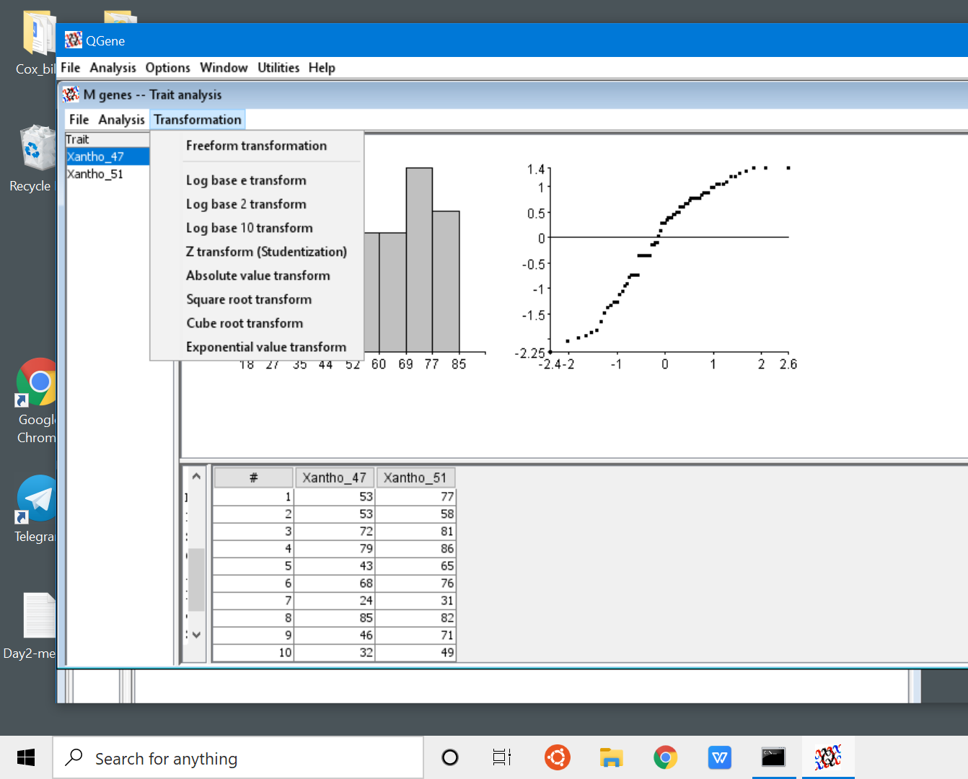
Transformation” - To convert data

Slide 46
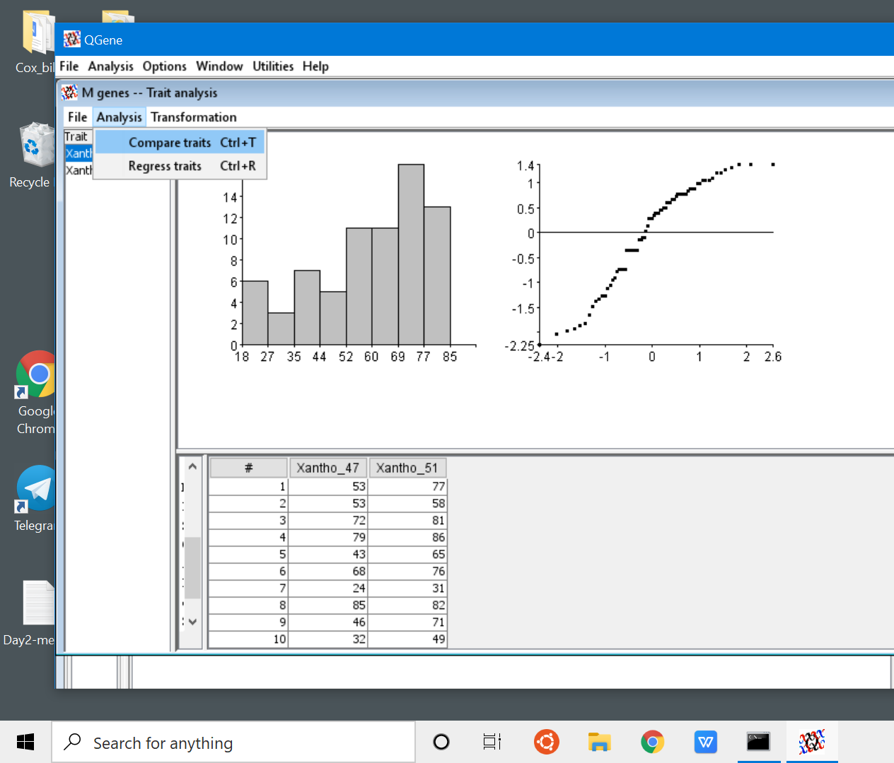
Analysis/Compare traits - to estimate correlation among different traits

Slide 47
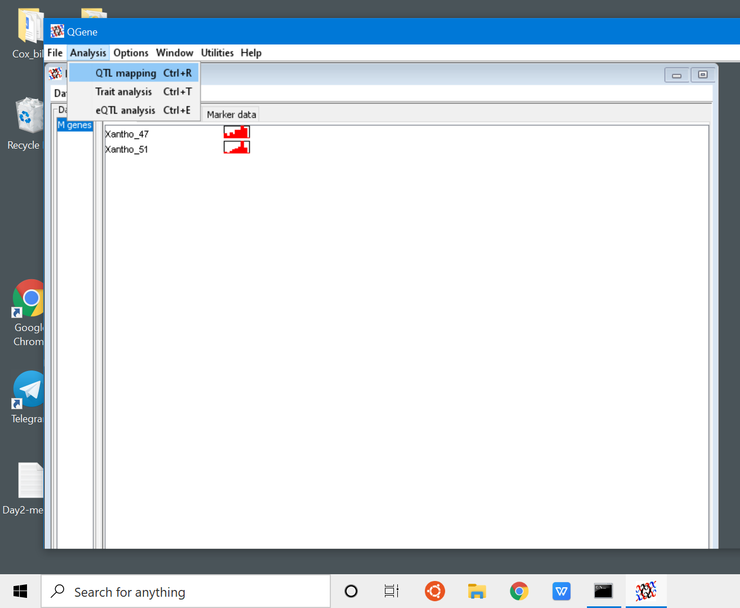
Analysis / QTL Mapping

Slide 48
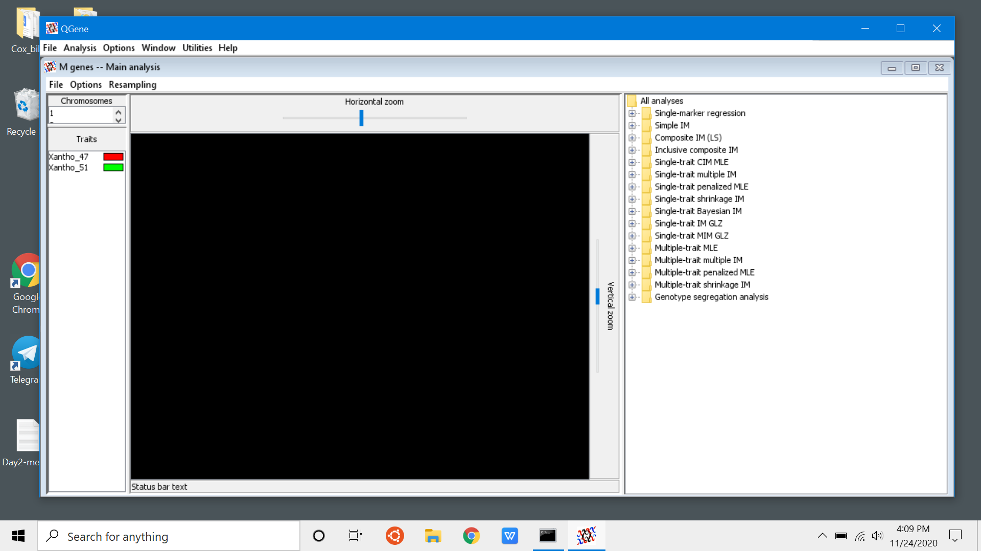
Various Windows - All adjustable in size

Slide 49
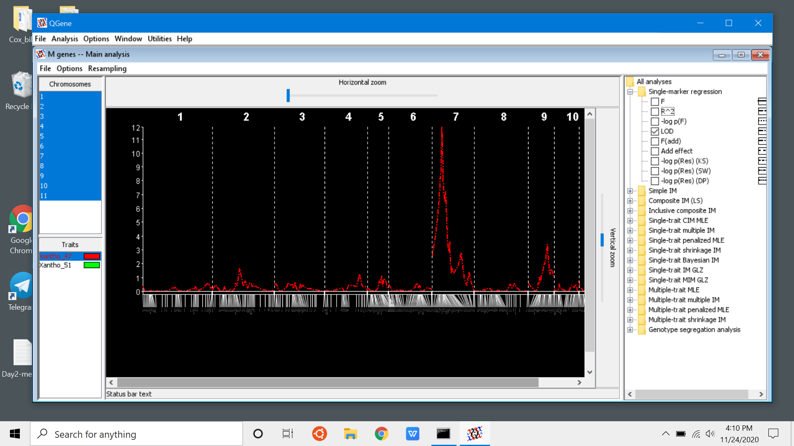
Single Marker regression (SMA) - LOD

Slide 50
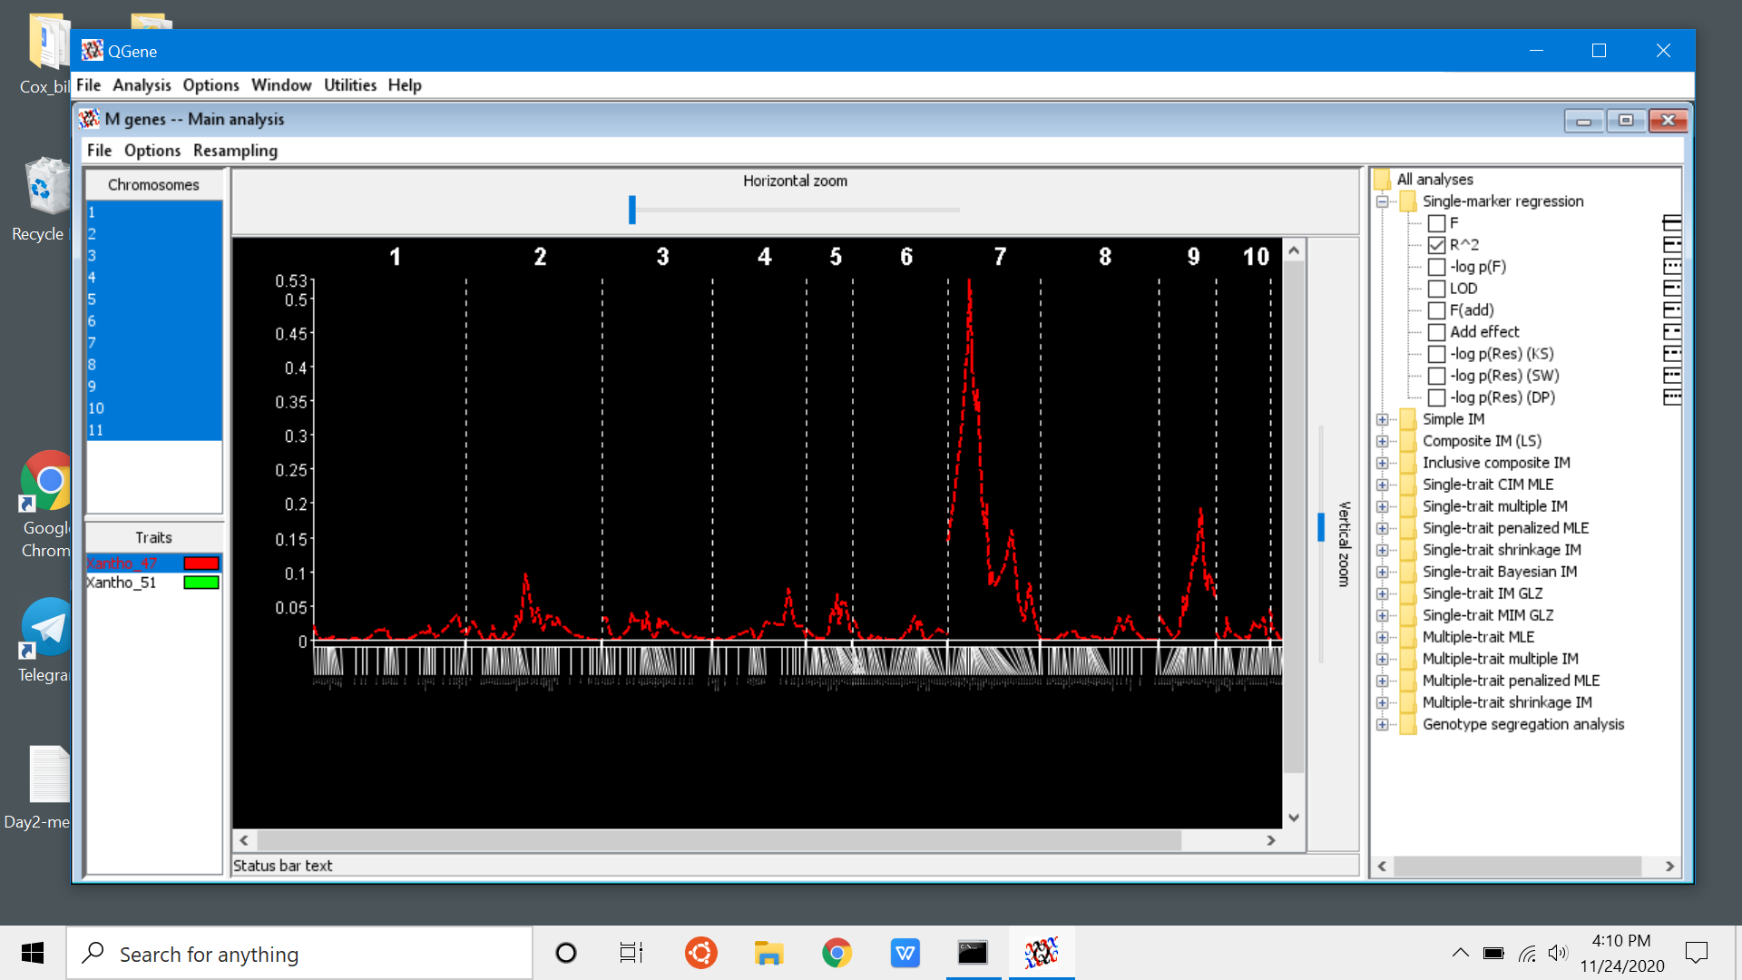
Single Marker Regression - R^2

Slide 51
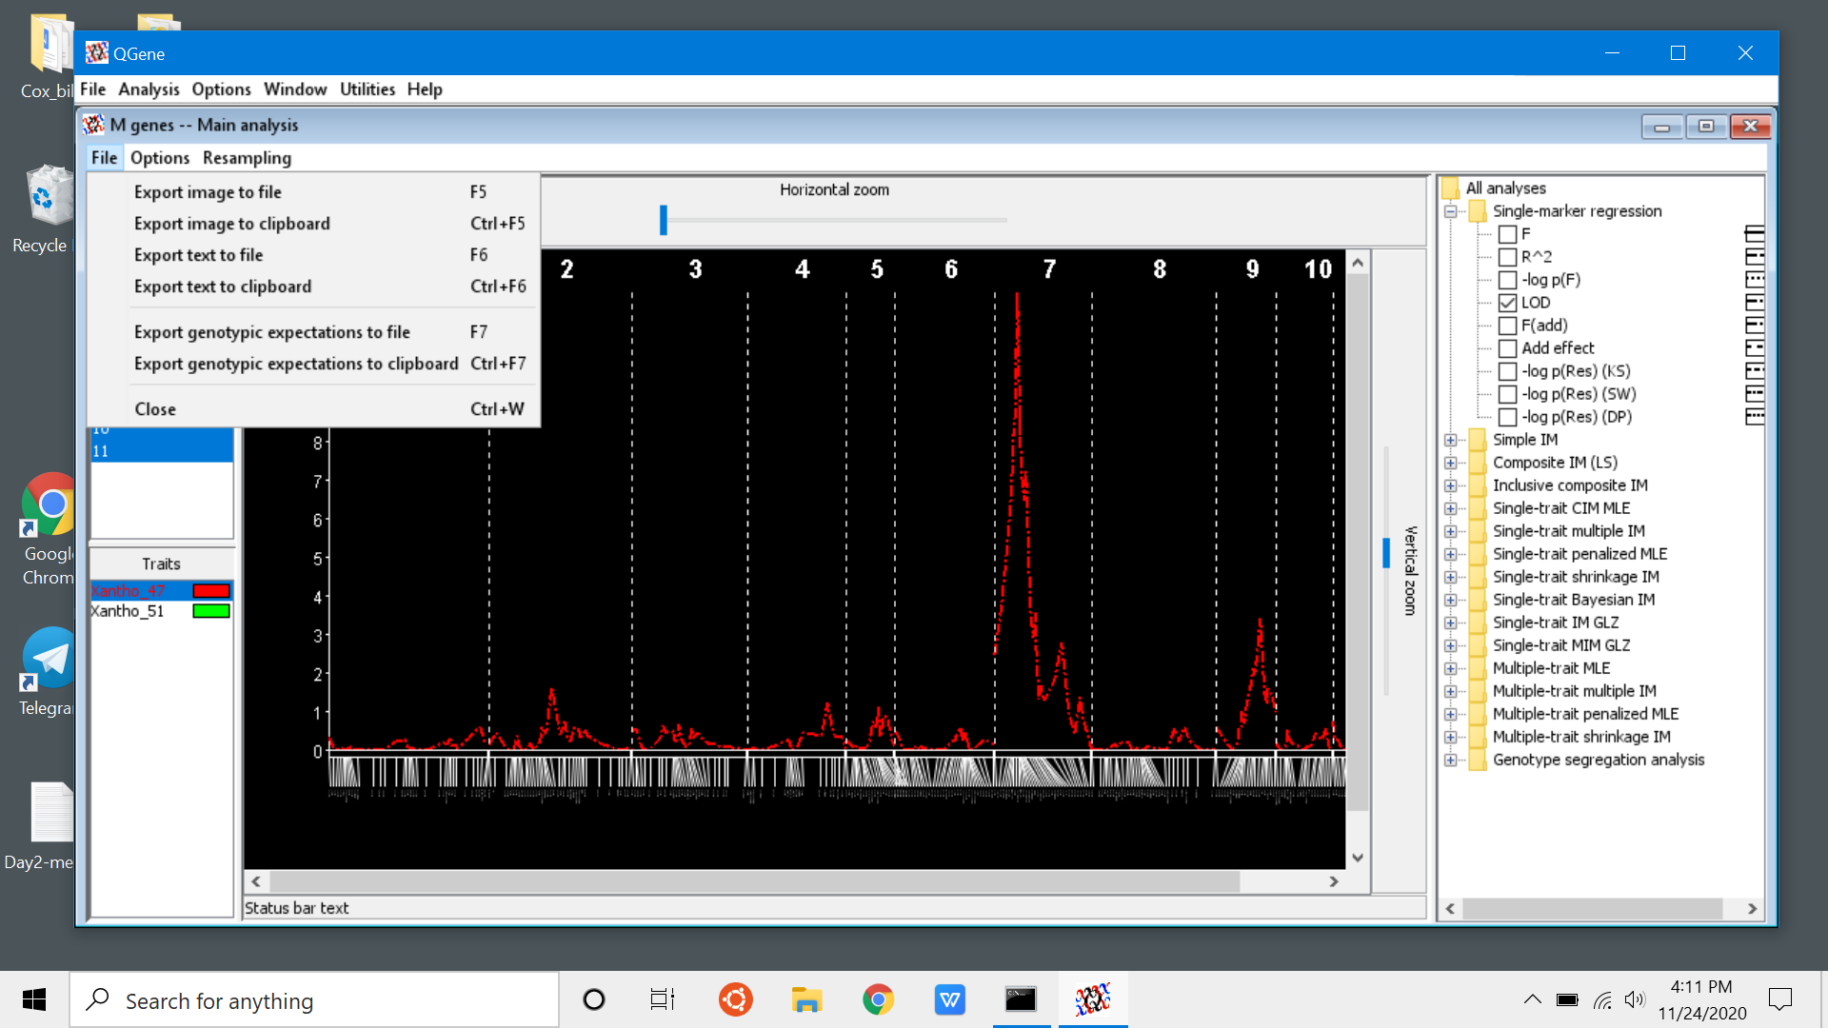
File options to save images and text

Slide 52
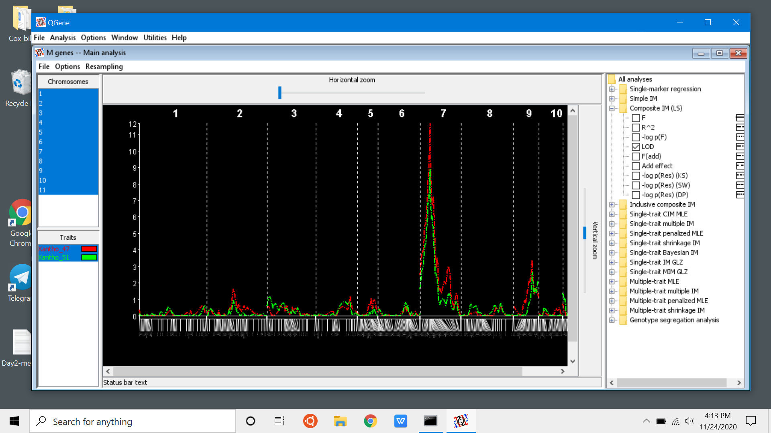
Composite Interval Mapping - LOD

Slide 53
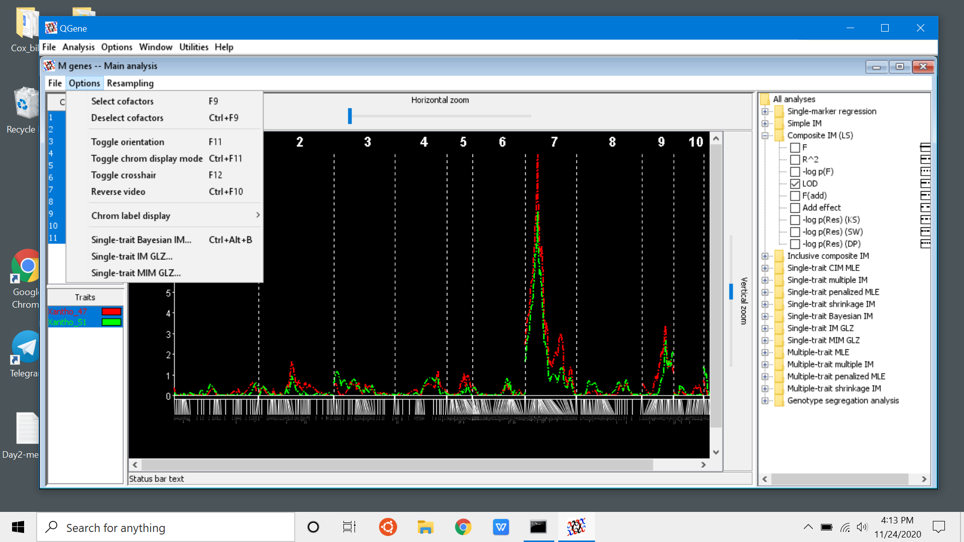
Options / select cofactors

Slide 54
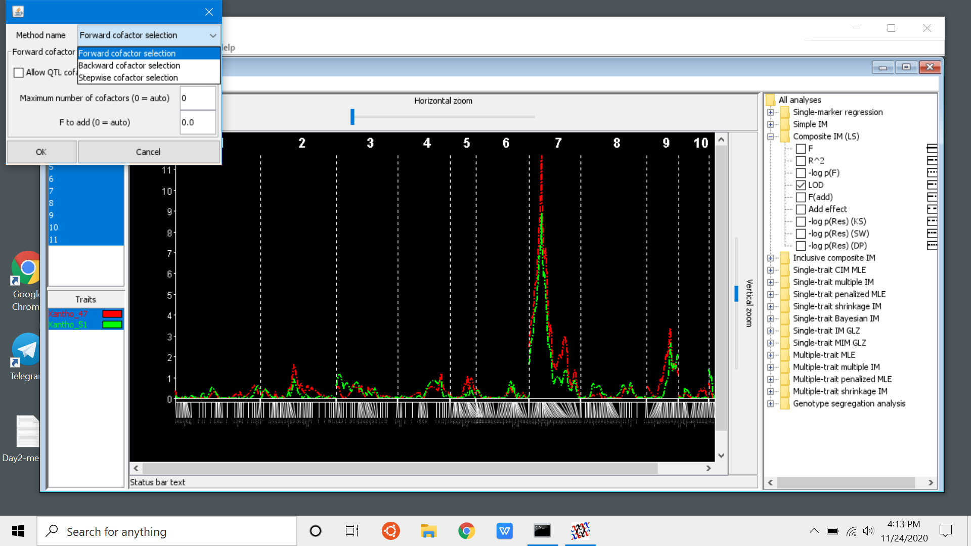
Select “Stepwise cofactor selection”

Slide 55

CIM - narrowed QTL region

Slide 56
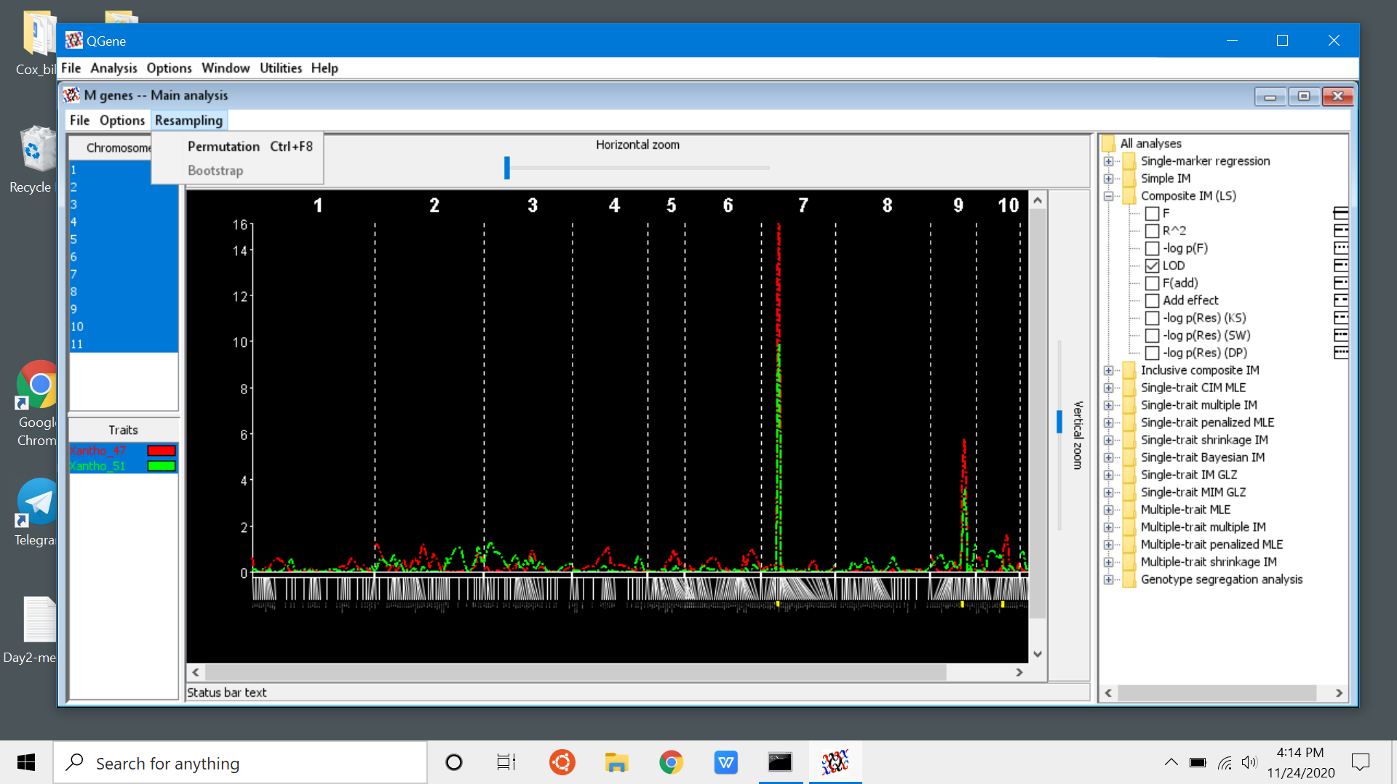
Resampling - to determine cutoffs

Slide 57
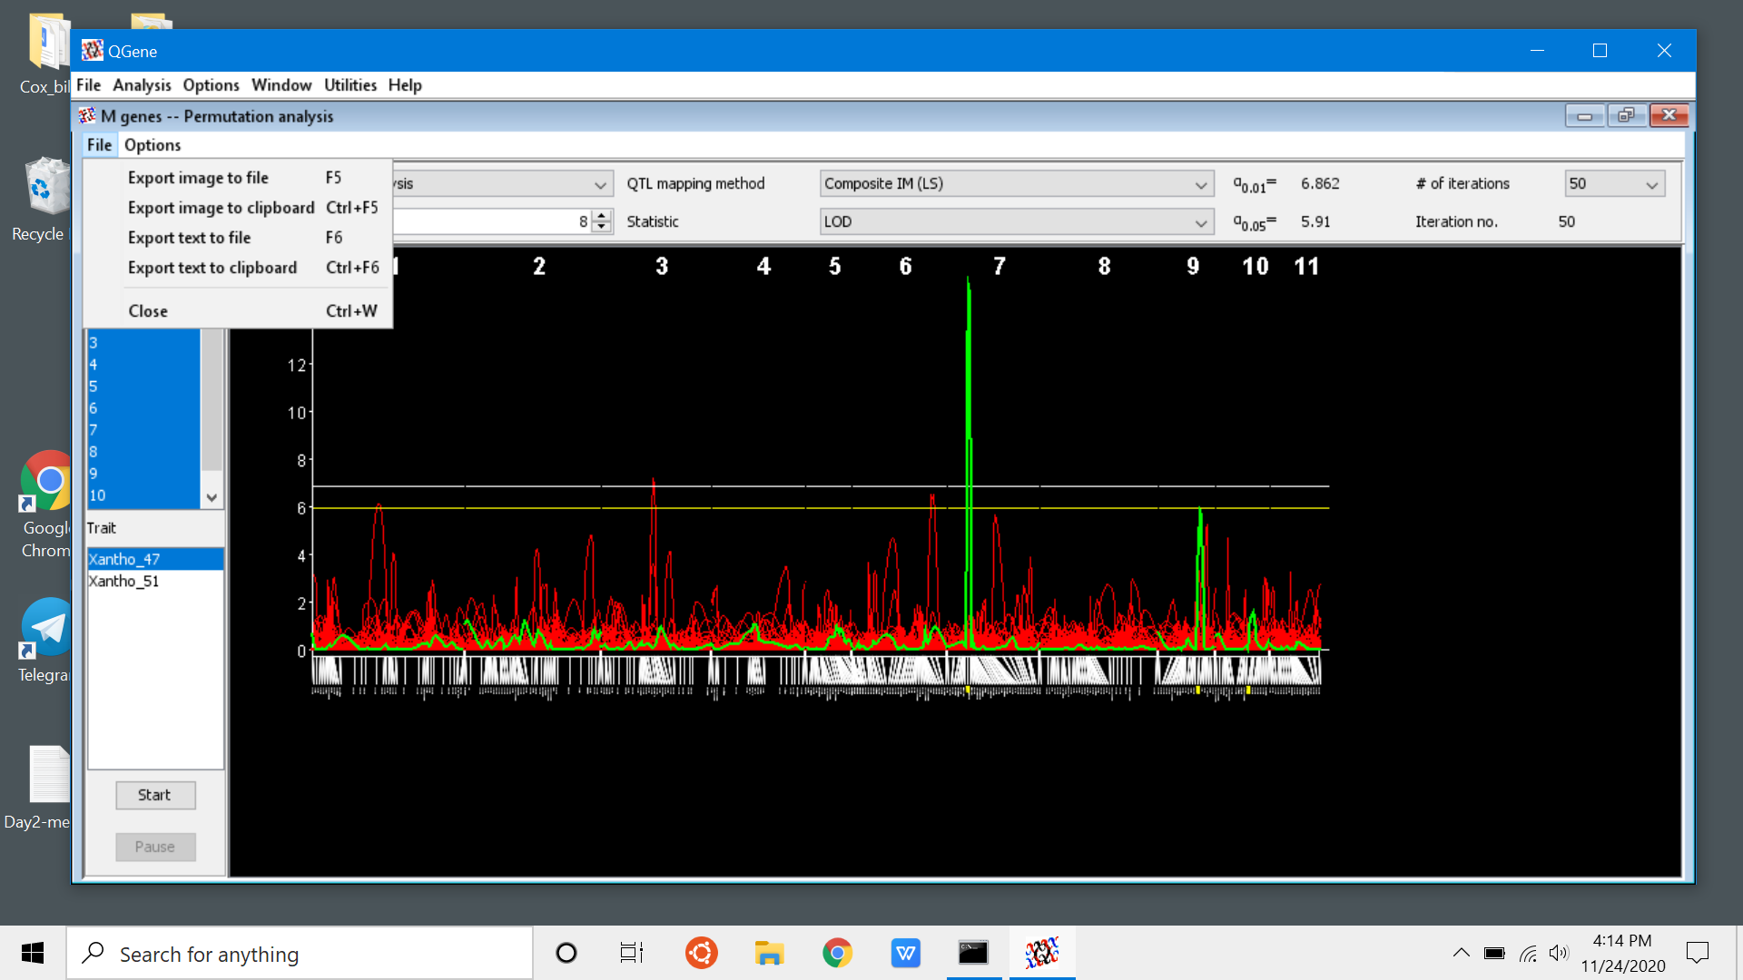
Note the cut -offs

Slide 58
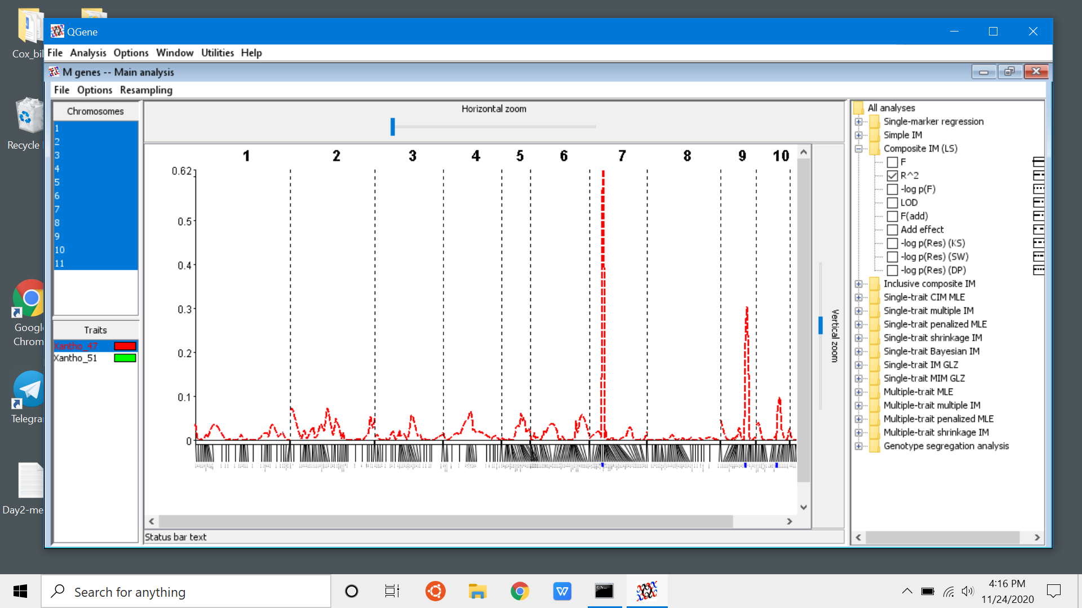
Final QTL image

